Slide 1
Intersectionality: A Short Introduction
Dr. Akwugo Emejulu, University of Edinburgh
Intersecting Childhood Identities, Inequalities and Rights Seminar Series
2nd December 2013
Notes:
Akwugo Emejulu
Lecturer, University of Edinburgh
Co-Director, Centre for Education for Racial Equality in Scotland
akwugo.emejulu@ed.ac.uk

Slide 2
Overview
What is intersectionality and why does it matter?
Thinking about difference and the impact of intersectional inequalities
Doing intersectionality

Slide 3
What is intersectionality?
‘An analytic sensibility’ (Cho et al 2013)
‘Concerns the way things work rather than who people are’ (Chun et al 2013)
‘The interaction between gender, race and other categories of difference…and the outcomes of these interactions in terms of power’ (Davis 2008)
Notes:
First thing to note is thatintersectionalityis a framework for understanding power and inequality. By seeking to trace systemic inequalities we can uncover ‘how things work’, who has power, how that power is sustained and what are the outcomes of the use of this kind of power.
Cho, S., Williams, K. and McCall, L. (2013) ‘Towards a field of intersectionality studies: Theory, applications and praxis’, Signs, 38(4): 785-810
Chun, J., Lipsitz, G. and Shin, Y. (2013) ‘Intersectionality as a social movement strategy: Asian Immigrant women advocates’, Signs, 38(4): 917-40.
Davis, K. (2008) ‘Intersectionality as buzzword: A sociology of science perspective on what makes a feminist theory successful’, Feminist Theory, 9(1): 67-85.

Slide 4
Taking difference seriously
Starting point for intersectionality is difference
Recognising how hierarchies of race, class, gender, disability, sexuality generate structural inequalities for particular groups
Understanding these inequalities are not effectively captured through dominant models that focus on individuals and/or homogenous groups

Slide 5
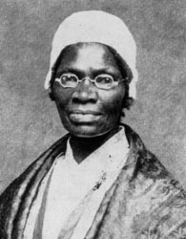
Ain’t I a Woman? Sojourner Truth (1851)
‘That man over there says
that women need to be
helped into carriages and
lifted over ditches and to
have the best place
everywhere. Nobody ever
helps me into carriages, or
over mud puddles or gives
me any best place! And ain’t
I a woman?’
Notes:
Truth, S. (1851) ‘Ain’t I a Woman?’ Speech given to the Women's Convention in Akron, Ohio. For an excellent performance of the full speech see: http://www.youtube.com/watch?v=eUdxsQ0Qsrc

Slide 6
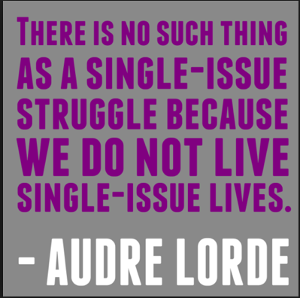
Inequalities at the intersections
Being located at particular intersections of difference matter in terms of socio-economic outcomes and power
Disparities in income and wealth and in public participation, media representations and respect are experienced at the intersections
Notes:
Lorde, A. (2013) Sister Outsider: Essays and Speeches. New York: Ten Speed Press.

Slide 7
Inequalities at the intersections
Poverty rates for all women are higher than those of white men in the UK
Poverty rates are lowest for white women, followed by Chinese, Indian, Black Caribbean and Black African women
Pakistani and Bangladeshi women have poverty rates of about 50% per cent(Nandi and Platt 2010)
Notes:
Nandi, A. and Platt, L. (2010) Ethnic Minority Women's Poverty and Economic Well Being. Government Equalities Office,
https://www.gov.uk/government/uploads/system/uploads/attachment_data/file/85529/ethnic-minority-women_s-poverty.pdf

Slide 8
Inequalities at the intersections
Notes:
Lily Allen is seeking to make a feminist video critiquing sexism and crass consumerism in the music industry and popular culture
But to which women is she referring? Why is she reproducing these problematic images? Why make this feminist point on the backs of black women?
For the full video see: http://www.youtube.com/watch?v=E0CazRHB0so

Slide 9
Intersectionality as praxis
Because intersectionality was born out of African American women’s social movements, it is about thoughtful and committed action
Intersectionality is not about defining groups as ‘victims’ but recognising inequalities and taking practical action to address power imbalances
So, how do you ‘do’ intersectionality?

Slide 10
Intersectionality and children’s rights
Which ‘children’ count in the dominant practices and campaigns in this field?
How do the dynamics of race/class/gender/sexuality/disability shape children’s lives?
How do these dynamics serve as resources for children?
What kinds of alliances need to be built across different groups to effectively address children’s intersectional inequalities?

